Slide 1

EMERTXE INFORMATION TECHNOLOGIES
Embedded Systems Internship Project Presentation
Project : Simulation of Washing Machine Using PICSIMLAB
-By
Name : shradha Sangave
College : SGGSIE &T, NANDED
413544

Slide 3
Things learnt in internship
Introduction to Embedded system
Basics of Embedded C
Introduction to Microcontroller and Microprocessor
Introduction and Project Requirements
Implementation Using MP Lab X IDE and PICSMLab

Slide 4
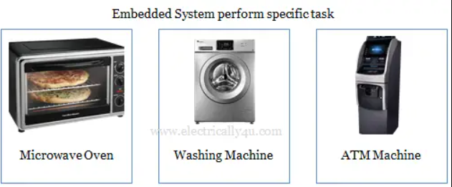
EMBEDDED SYSTEMS
Combination of Hardware and Software
Programming Using Embedded C
Eg. Washing Machines, Microwave oven, AC, Refrigerator, etc

Slide 5
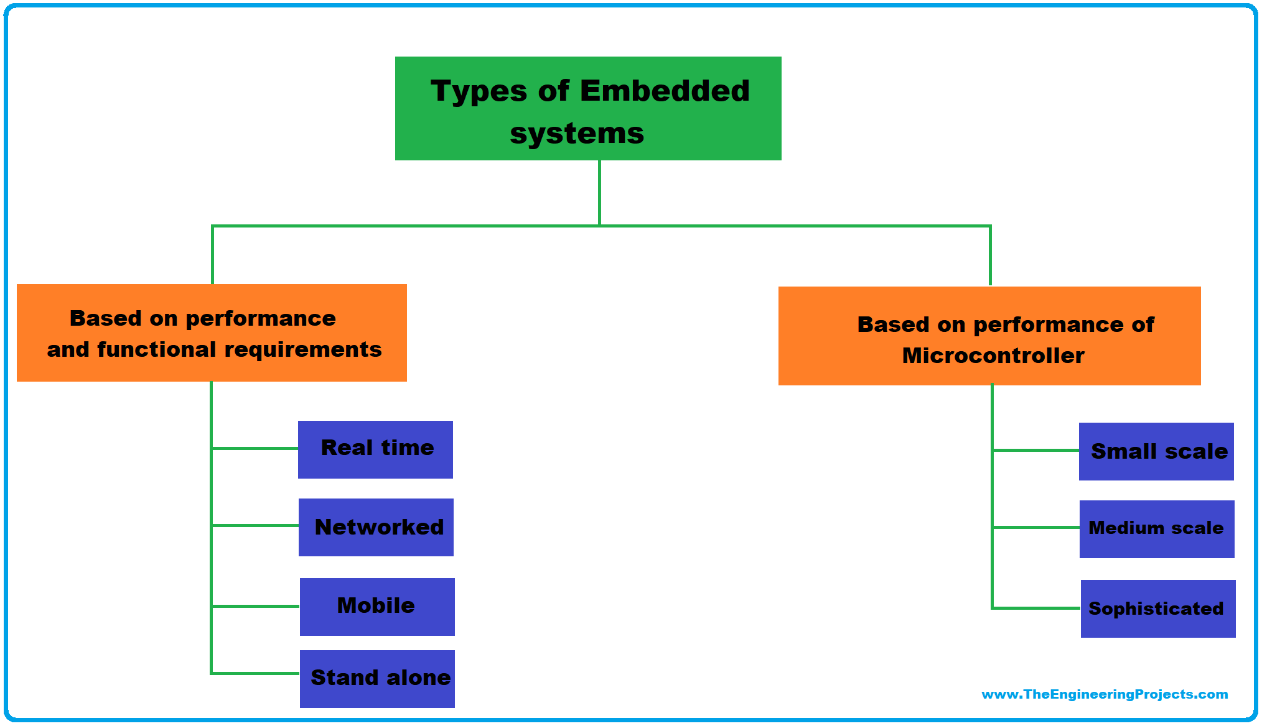
Embedded systems

Slide 6
Basics of embedded c
Usages of Embedded C
Characteristics of Embedded C
Code format
Data Types & Number Systems
Conditional Constructs
Used in System Software, Embedded Software, OS Kernal development and more
General Purpose Language and has Library Facilities
Documentations, Preprocessor language and has Library facilities
integral and floating point ; Decimal, Octal, Hexadecimal, Binary
Looping : For , While < Do While

Slide 7
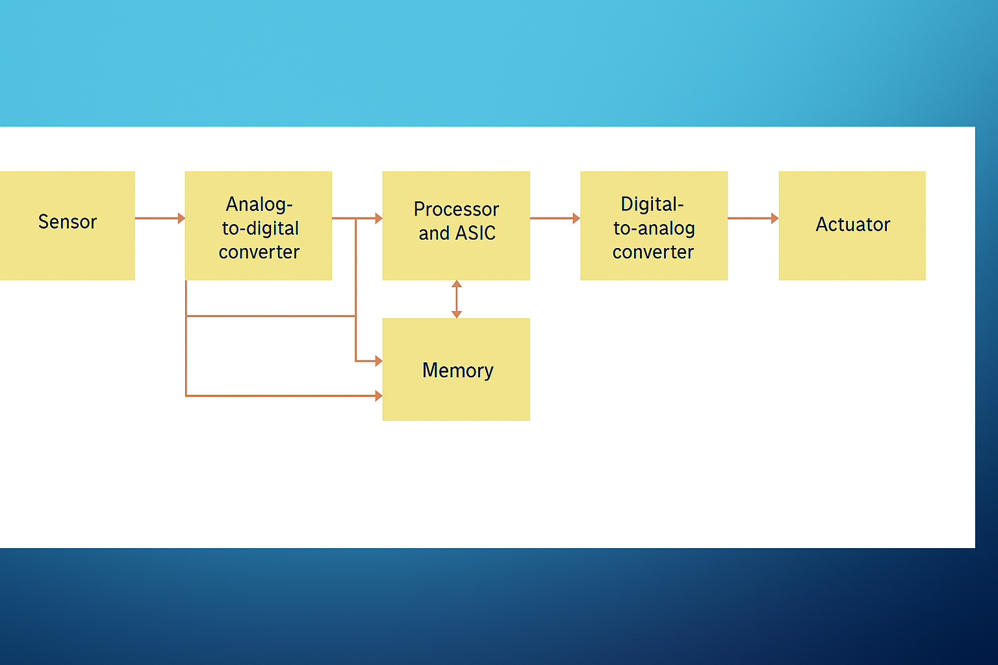
Blocks of embedded systems

Slide 8
microcontroller
IC capable of being programmed to perform a task
Has simple Design architecture
All Components are available in a single chip
microprocessor
IC Capable of being programmed to perform any task
Comparatively Complex design architecture
Peripherals need to be interfaced

Slide 9
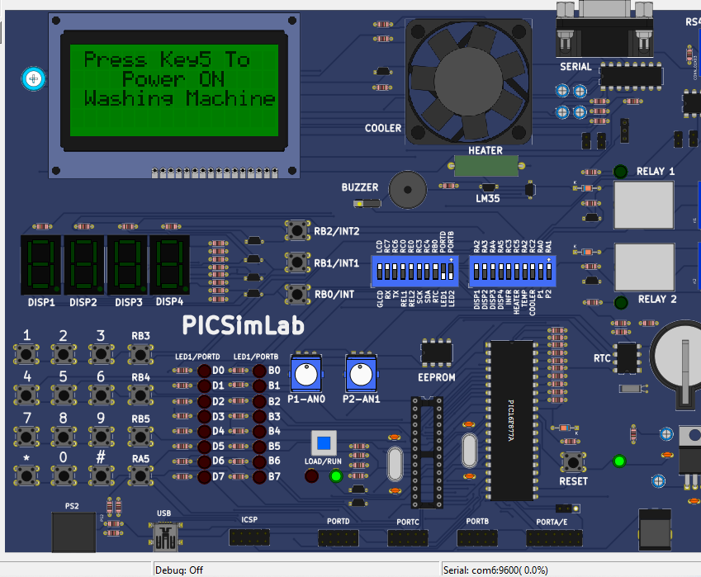
PIC16F877A BOARD
The Operating Frequency of the board is 20MHZ.
The Flash program memory is of size 368 bytes.
EEPROM Data memory is if size 256 bytes.
There are 15 interrupts in the board
The I/O ports are 5-A,B,C,D,E.
3 Timers , 2PWM modules.
It also has various components like CLCD, Fan, Tactile Switches, Buzzers, LESs, ADC, RS232, etc.

Slide 10

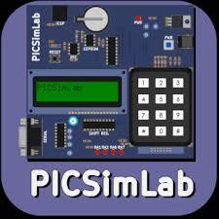
PROJECT REQUIRMENTS
Goal : Simulating a washing machine using Picsimlab replicating a real-world washing machine.
Microcontroller Used : PIC16F877A
Software Used :
1. MP Lab X IDE
2. PICSIMLAB
3.XC8 Compiler

Slide 11
PROJECT REQUIRMENTS
MP Lab X IDE :
MP Lab is a proprietary freeware IDE
It is developed by Microchip Technologies
it is being used for programming and development purpose for embedded systems
The version which we have used for our project is v5.35

Slide 12
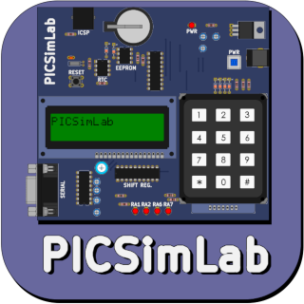
Project requirements
PICSIMLab
PICSIMLab is a proprietary free software for simulation of various microcontroller boards available
It can simulate most of the widely used microcontroller boards like PIC, Arduino, STM32, ESP32, etc.

Slide 13
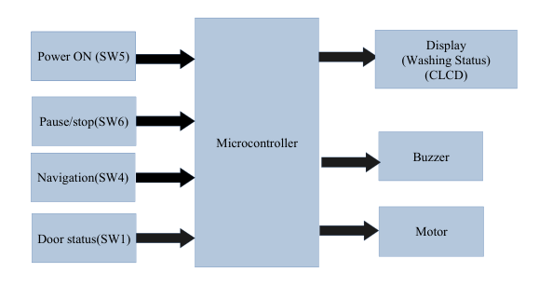
Block diagram

Slide 14
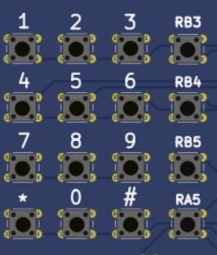
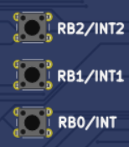
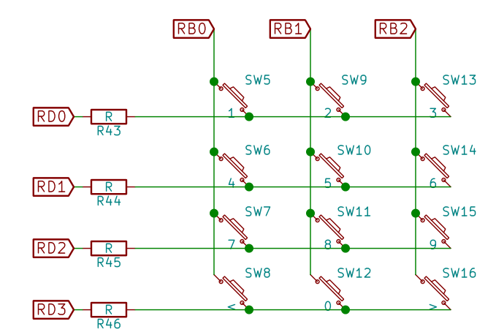
Component used
Tactile Switches :
These are the Switches which will be ON mode only when the switches is pressed
Here, the RB3 is used as switch 4 _ Navigation (scrolling) between Options.
The RB4 is used as switch 5_ powering on the washing machine and resume
The RB5 is used as switch 6 – stop and pause the ongoing program.
The RB0 is used as Switch to indicate door status of washing machine

Slide 15
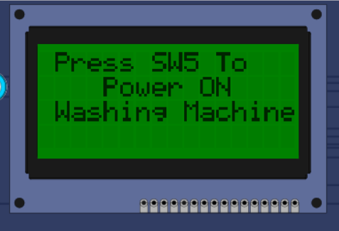
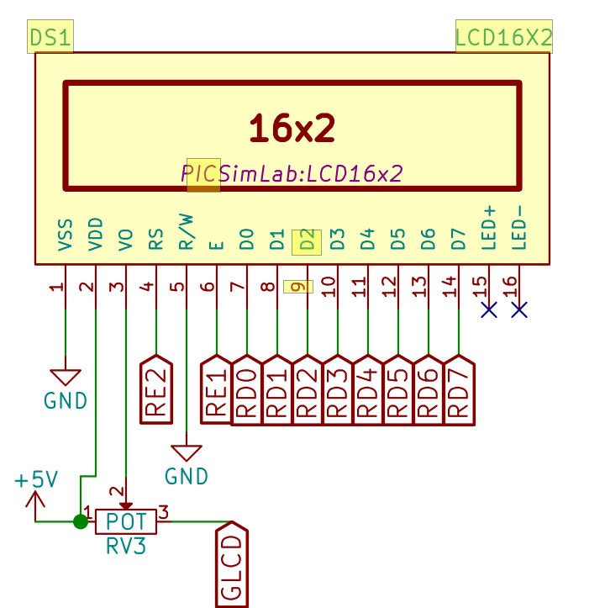
Components used
CLCD :
The CLCD in Washing machine used for displaying the current status of the machine.
It is also used to show Various Options and to Navigate through them using switches.
It is also showing the time remaining to finish the program and also shows the wash mode

Slide 16
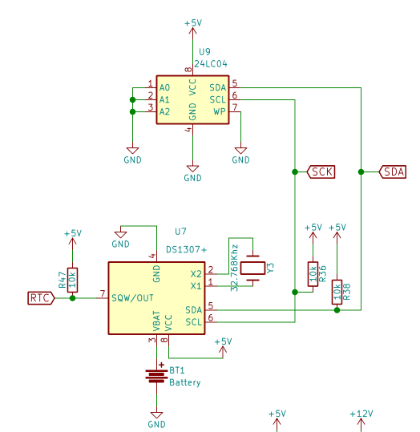
Components used
Timers
The timer in Washing machine is used to keep in track of the washing timers
In the normal Washing Mode, the time is spilt into three washing mode, Wash , Rinse and Spin.
The timer for each is spilt into certain interval and the same is displayed in CLCD

Slide 17

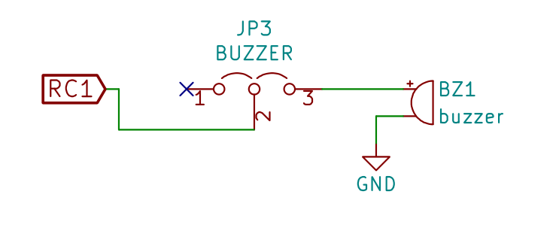
Components used
BUZZER
The Buzzer in washing machine is used to keep in track of the washing machine cycle.
The buzzer alarm activates when the door of the washing machine is opened , which is opened , which is represented by clicking the RB0 buttons
It also activates for 3 seconds when the washing is completely successfully

Slide 18
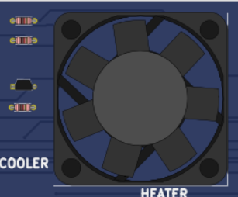
Components used
FAN
The fan in the project is used to represent the working of Washing Machine
The spin of the motor starts when any washing mode is selected and continues till the end of the washing cycle.
The motor stops When it detects door is opened, and starts again when the door is closed

Slide 19
conclusion
In conclusion, our washing machine simulation using the PIC16F877A microcontroller demonstrates not only the practical application of embedded systems in household appliances but also the versatility of microcontroller-based designs.
The ease of programming the microcontroller increases the efficiency and can be very handy to create and develop advanced machines using microcontrollers.
They also play a vital role in the development of technology.

Slide 20
Thank you

